Slide 1
HOBBIES
MADE BY: EDUARD,GEORGIA,VLAD,SEBASTIAN,GIULIA,DENIS

Slide 2
Sports
Basketball is a team sport in which two teams, most commonly of five players each, opposing one another on a rectangular court, compete with the primary objective of shooting a basketball through the defender’s hoop while preventing the opposing team from shooting through their own hoop.
Tennis is a racket sport that can be played individually against a single opponent or between two teams of two players each. Each player uses a tennis racket that is strung with cord to strike a hollow rubber ball covered with felt over or around a net and into the opponent's court.
Association football, more commonly known as football or soccer, is a team sport played with a spherical ball between two teams of eleven players. It is played by 250 million players in over 200 countries and dependencies, making it the world's most popular sport.
Chess is a two-player strategy board game played on a chessboard, a checkered gameboard with 64 squares arranged in an 8×8 grid. The game is played by millions of people worldwide. Chess is believed to be derived from the Indian game chaturanga some time before the 7th century.

Slide 3
Another sports
Running is a method of terrestrial locomotion allowing humans and other animals to move rapidly on foot. Running is a type of gait characterized by an aerial phase in which all feet are above the ground.
Swimming is an individual or team sport that requires the use of one's entire body to move through water. The sport takes place in pools or open water. Competitive swimming is one of the most popular Olympic sports, with varied distance events in butterfly, backstroke, breaststroke, freestyle, and individual medley.
Karate is a martial art developed in the Ryukyu Kingdom. It developed from the indigenous Ryukyuan martial arts under the influence of Chinese Kung Fu, particularly Fujian White Crane.
Ten-pin bowling is a type of bowling in which a bowler rolls a bowling ball down a wood or synthetic lane toward ten pins positioned in a tetractys at the far end of the lane. The objective is to knock down all ten pins on the first roll of the ball.
Taekwondo is a Korean martial art, characterized by its emphasis on head-height kicks, jumping and spinning kicks, and fast kicking techniques.

Slide 4
Arts
Cooking or cookery is the art, technology, science and craft of preparing food for consumption. Cooking techniques and ingredients vary widely across the world, from grilling food over an open fire to using electric stoves, to baking in various types of ovens, reflecting unique environmental, economic, and cultural traditions and trends. The ways or types of cooking also depend on the skill and type of training an individual cook has. Cooking is done both by people in their own dwellings and by professional cooks and chefs in restaurants and other food establishments. Cooking can also occur through chemical reactions without the presence of heat, such as in ceviche, a traditional South American dish where fish is cooked with the acids in lemon or lime juice.
Nail art is a creative way to paint, decorate, enhance, and embellish the nails. It is a type of artwork that can be done on fingernails and toenails, usually after manicures or pedicures. A manicure and a pedicure are beauty treatments that trim, shape, and polish the nail.

Slide 5
Some more arts
Origami is the art of paper folding, which is often associated with Japanese culture. In modern usage, the word "origami" is used as an inclusive term for all folding practices, regardless of their culture of origin.
A photograph is an image created by light falling on a photosensitive surface, usually photographic film or an electronic image sensor, such as a CCD or a CMOS chip.
Photography is the art, application and practice of creating durable images by recording light or other electromagnetic radiation, either electronically by means of an image sensor, or chemically by means of a light-sensitive material such as photographic film.
Digital photography uses cameras containing arrays of electronic photodetectors to capture images focused by a lens, as opposed to an exposure on photographic film. The captured images are digitized and stored as a computer file ready for further digital processing, viewing, digital publishing or printing.
Drawing is a form of visual art in which a person uses various drawing instruments to mark paper or another two-dimensional medium.

Slide 6
More hobbies
Reading is the complex cognitive process of decoding symbols to derive meaning. It is a form of language processing.
Shopping is an activity in which a customer browses the available goods or services presented by one or more retailers with the potential intent to purchase a suitable selection of them. A typology of shopper types has been developed by scholars which identifies one group of shoppers as recreational shoppers,^{[1]} that is, those who enjoy shopping and view it as a leisureactivity.
Storytelling describes the social and cultural activity of sharing stories, sometimes with improvisation, theatrics, or embellishment. Every culture has its own stories or narratives, which are shared as a means of entertainment, education, cultural preservation or instilling moral values.
Dance is a performing art form consisting of purposefully selected sequences of human movement. This movement has aesthetic and symbolic value, and is acknowledged as dance by performers and observers within a particular culture.
Acting the art or occupation of performing fictional roles in plays, films, or television.

Slide 7
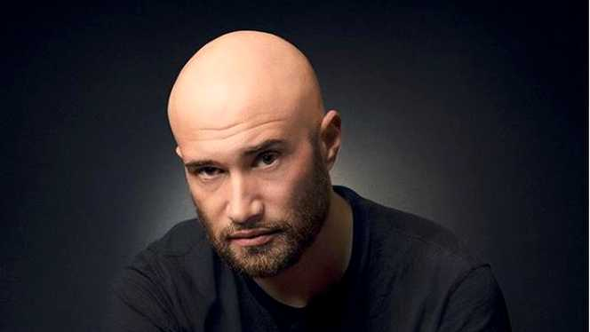

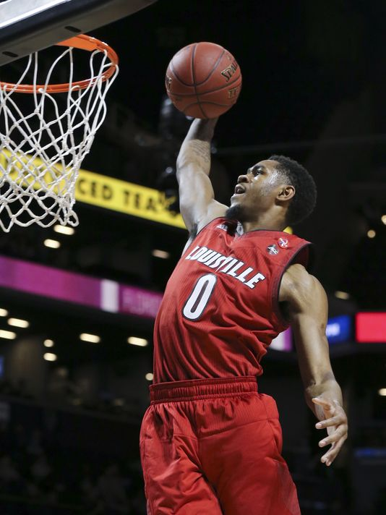
Pictures with hobbies

Slide 8
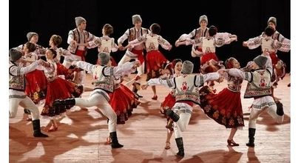

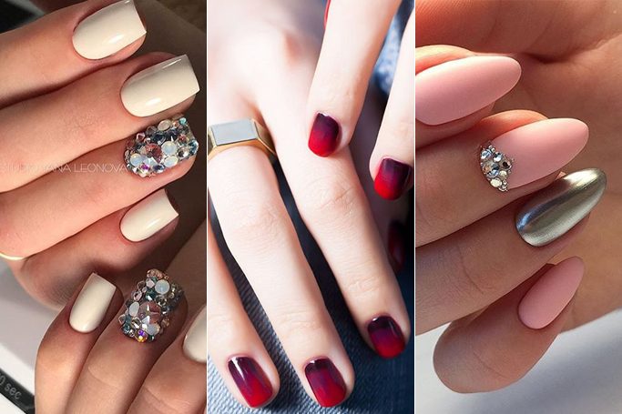
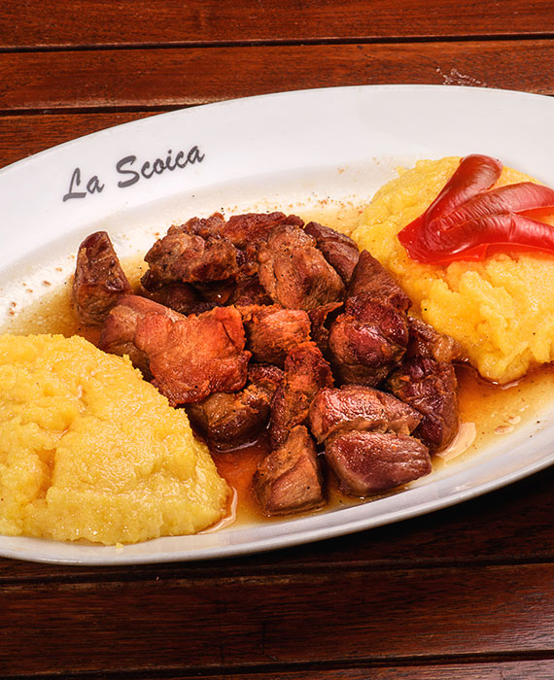
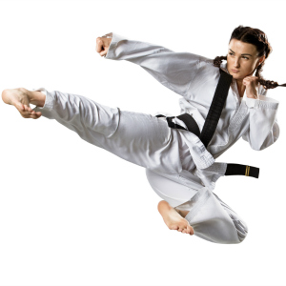
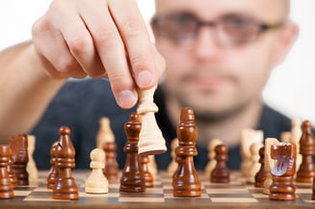

Slide 9
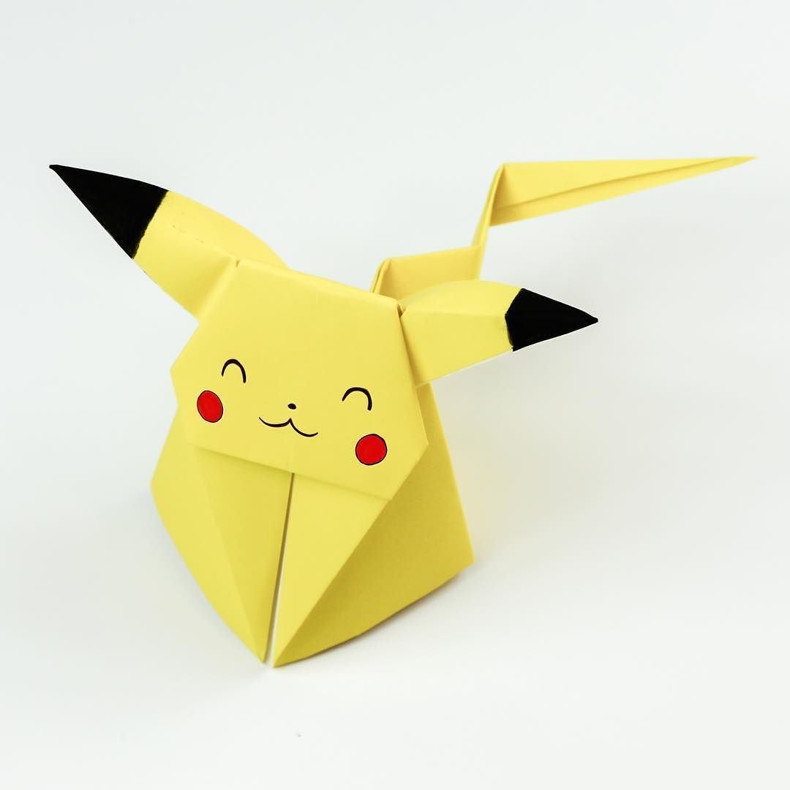

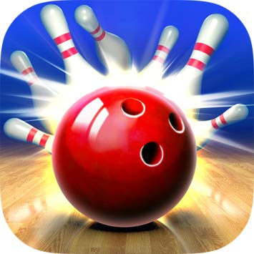
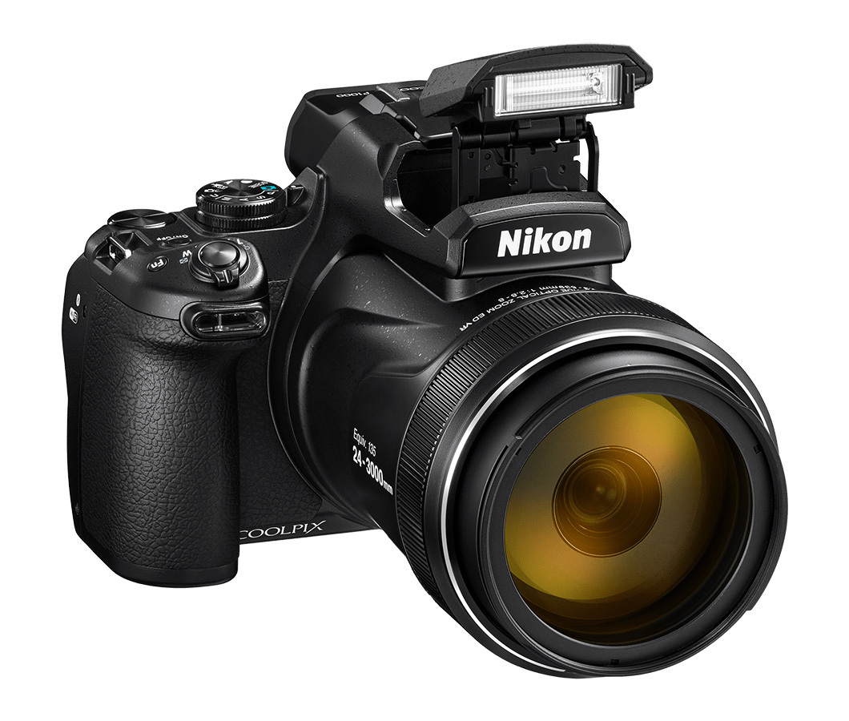
These are Some Hobbies from Romania
Thanks for watching

