Slide 1

Myths and Legends from Romania
by:Denis,Edi,Georgia,Giulia,Sebi,Vlad

Slide 2
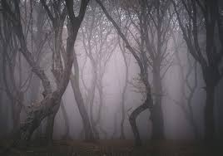
The Hoia Baciu Forest
Locals had known about the strange things happening in the Baciu Forest for a long time. Legends and myths have been passed down from generation to generation. They think that once entered, the forest awakes man’s deepest, subconscious fears. The villagers that entered the forest testified that as soon as they reached it, they experienced inexplicable states of nausea, anxiety, headaches and even burn marks on their skin.

Slide 3
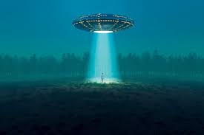
The name of the forest means the Shepherd’s forest. It is inspired by one of these legends. It is said that one day the shepherd of the nearby village entered with his flock into the forest and disappeared with all of the sheep and was seen again. From that moment on it was named after him.
What truly sets the doubt on this not being just another Dracula story is that besides these physical and mental alterations, the forest also pushes the boundaries of science by showing signs of magnetic anomalies, fluctuations of the electromagnetic field and infra-sound emissions.
The person that started a true scientific investigation regarding the strange forest, was biologist Alexandru Sift. Attracted by the amazing stories he would hear from the locals he decided to see first-hand what all the fuss was about. In the ’50’s he made several trips to the forest, taking numerous pictures.
He claimed that on these incursions inside the forest he would see strange shadows among the trees, following him. Nonetheless, he did not abandon his project, and, when he took out his photos, his mind stuttered – shapes that were not supposed to be there, shadows, and even the fact that the pictures on the camera were not in the same order as he had taken them in the forest was strange. His research was a landmark for all future explorers.
The forest took its rise to fame in 1968 with a documented UFO appearance.

Slide 4
Dracula
Some say that Transylvania sits on one of Earth's strongest magnetic fields and its people have extra-sensory perception. Vampires are believed to hang around crossroads on St. George's Day, April 23, and the eve of St. Andrew, November 29. The area is also home to Bram Stoker's Dracula, and it's easy to get caught up in the tale while driving along winding roads through dense, dark, ancient forests and over mountain passes.
Dracula is literally translated in Gaelic as Drac Ullah meaning bad blood.
Tales of the supernatural had been circulating in Romanian folklore for centuries when Irish writer Bram Stoker picked up the thread and spun it into a golden tale of ghoulishness that has never been out of print since its first publication in 1897. To research his immortal tale, Stoker immersed himself in the history, lore and legends of Transylvania, which he called a "whirlpool for the imagination."
Bram Stoker's Dracula novel was published in Romanian for the first time in 1990.
Count Dracula, a fictional character in the Dracula novel, was inspired by one of the best-known figures of Romanian history, Vlad Dracula, nicknamed Vlad Tepes (Vlad the Impaler), who was the ruler of Walachia at various times from 1456-1462. Born in 1431 in Sighisoara, he resided all his adult life in Walachia, except for periods of imprisonment at Pest and Visegrad (in Hungary)

Slide 5
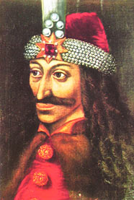
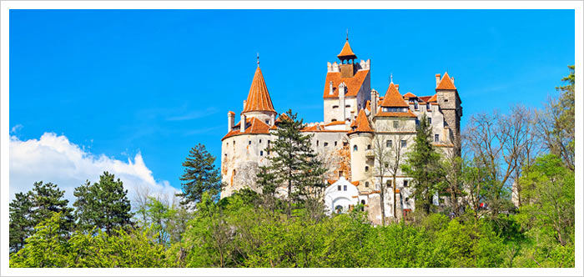
Some pictures with Dracula

Slide 6
The Red Lake
The Red Lake is the largest barrier lake in the Eastern Carpathian Mountains. It is located at the foothills of the Hășmașul Mare Mountain, near the Bicaz Gorges, and it was formed after the collapse of a slope caused by an earthquake in 1838.
The Red Lake got its name from the nearby Red Creek, which is filled with various alluvia of a reddish color, such as iron oxide and hydroxide.
The lake is a great tourist attraction having a valley that is safeguarded by strong winds. The clean and rich air and the picturesque surroundings offer conditions for relaxation, and near the lake , there are several merchants who sell souvenirs and local street food.

Slide 7
The Legend of The Red Lake
The Red Lake was also known as the Killer Lake, and there's a legend behind that name. It is said that when the slope collapsed over the nearby village, the landfall killed most of the inhabitants of the village, as well the animals. In the water was so much blood from all the victims, that the lake got the name of The Red Lake or The Killer Lake.
To make matters more creepy, of the forest that was covered by the lake only tree stumps remained, and over time they got turned into stone due to the sediments. Now, the spruce trunks that barely come out of the water look just like tombstones.

Slide 8
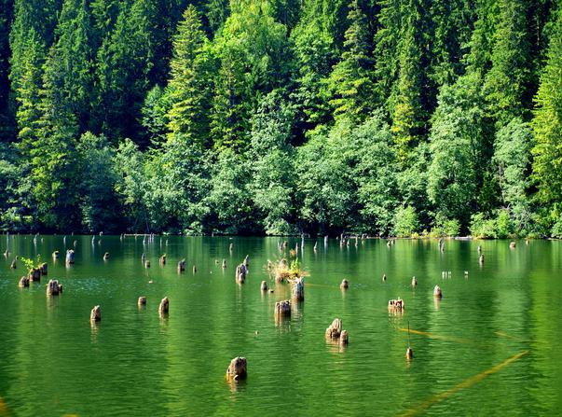
the Red Lake

Slide 9
The Dacian Fortresses in the Orastie Mountains
The six surviving Dacian fortresses (Costesti-Cetatuie, Costesti-Blidaru, Luncani-Piatra Rosie, Sarmizegetusa Regia, Banita, and Capalna) used to be part of a system of fortifications built by the Dacians in the first century BC around their capital, Sarmizegetusa. Their location, at the top of virtually inaccessible hills, surrounded by thick walls, hint to their exclusively defensive purpose. The walls were built according to a unique technology, using materials brought from far off. Since 1999 it's a part of the UNESCO World Heritage.
Outside the fortresses, archaeologists have uncovered rectangular and around temples, built to worship Zalmoxes, the Dacians' supreme god. Once the capital of a great kingdom, the Dacian city of Sarmizegetusa fell victim to the cruelties of war during the confrontations with the Romans between 101-102 and 105-106. In order to stop the Dacians from retaliating against them, the Romans destroyed its walls, burned down its temples and relocated the capital. What remains today are stone ruins, offering just a glimpse of the monumental constructions put up by the Dacians of old.

Slide 10
Sarmizegetusa Regia - most famous Dacian fortresses
The most famous of all Dacian fortresses is Sarmizegetusa Regia with evidence of astronomical knowledge. Many comparative analyses between Sarmizegetusa and Stonehenge have been carried out. It emerged that the alignment of the two sanctuaries is similar.Here,four rectangular sanctuaries, two circular sanctuaries, and a solar disk have been identified. These are all the result of the archetypal teachings on time philosophy. From both a sacerdotal and lay point of view, they are spelled out in astronomical and calendar terms.
The sacred area at Sarmizegetusa hosted several religious sanctuaries. The great sanctuary served as a temple-calendar. It is structured around three concentric circles and a horseshoe-shaped internal apse. The first circle was made of 104 andesite blocks, the second of 180 andesite posts and the third of 82 thick timber posts. Researchers and historians diverge only with regard to the usage of the sanctuaries, whereas from a mathematical point of view, the absolute originality of the Dacian calendar and its surprising preciseness has been fully demonstrated.

Slide 11
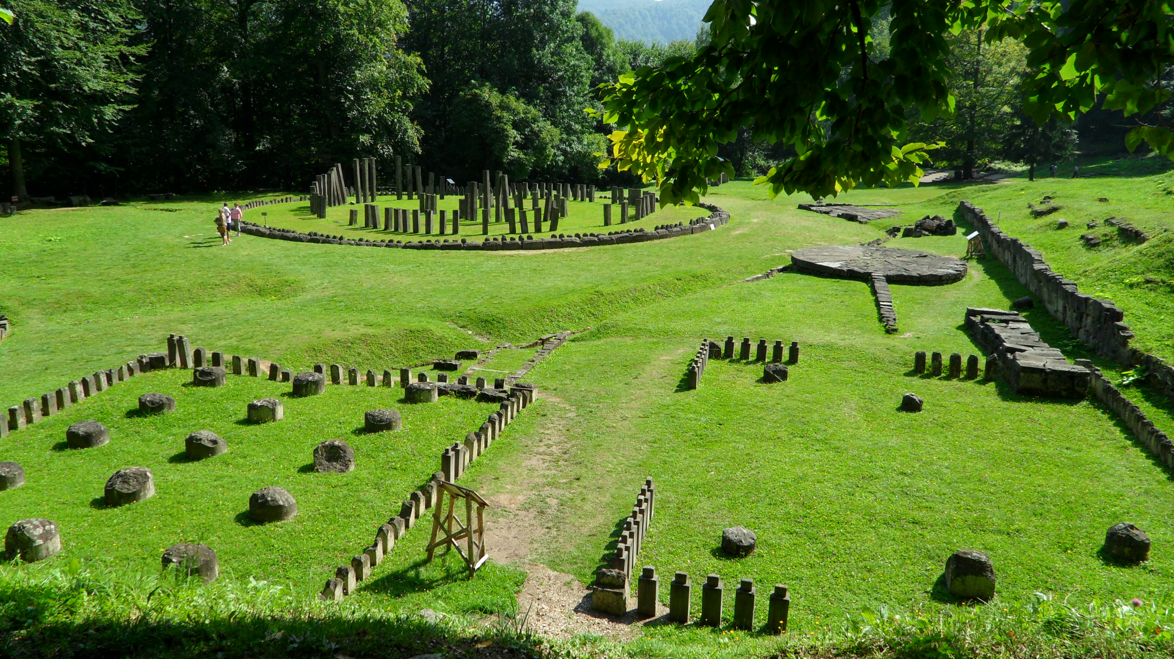
Picture with Sarmizegetusa

Slide 12
THE LEGEND OF THE MASTER BUILDER MANOLE
The legend says that Prince Negru Voda (Radu Negru) the founder of Wallachia, with nine great masters and Manole the tenth, were looking down Arges river for a place to build the most beautiful monastery. During construction, because the walls of the monastery would continuously crumble, the Prince threatened to kill Manole and his workers.
Desperate about the way construction went, one night Manole had a dream in which he was told that, for the monastery to be built, he had to incorporate into its walls some person very loved by him or his masons. He told his masons about his dream, and they agreed that the first wife who would come there with lunch for her husband the following day, should be the one to be built into the walls of the monastery so that their art would last. Ana, Manole’s wife who was pregnant, was the one that came first and although the master asked God to stop her on the way, nothing couldn’t prevent her sacrifice. Ana’s edifying is the most exciting part of the legend. The unique Monastery was built, and Manole, remained on the roof, after removing scaffolding, from the voivod’s command, because he didn’t want them to build a more beautiful monastery anymore. Manole and the other builders made themselves light wings made of wood because they wanted to fly. In the place where his flight was broken, emerged a spring with clear water (Manole’s Fountain) which testifies today that the his soul remains immortal.

Slide 13
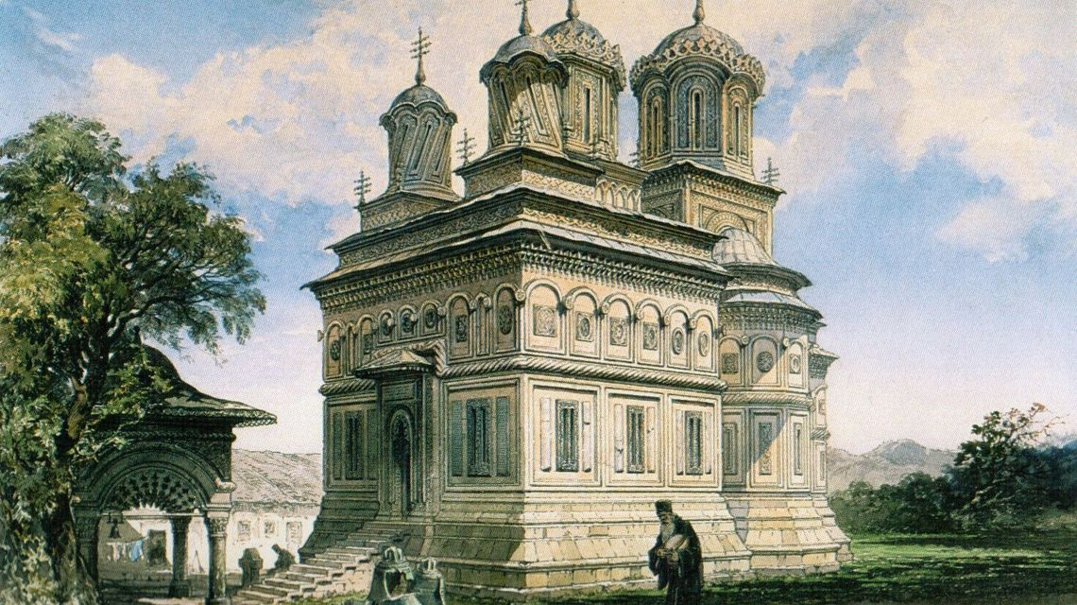
Picture with Arges Monastery built by Master Manole

Slide 14
The Dragon’s Garden
The Dragons’ Garden is located at the edge of a small village in Sălaj County, called Gâlgău Almaşului and it is considered one of the most beautiful places in Romania. It is an ensemble of irregularly-shaped rocks that came off Inchieturi Hill.The wind, rain, snow and frost shaped them into the strangest looking formations, which have been likened to columns, ramparts, bridges and mushrooms.
Equally fascinating is the way that folk imagination has breathed life into these rocks and made them into mythical characters. Each of them has a name and a story that make it unique.
One legend says that the rocks were formed in the aftermath of an epic battle between the forces of evil and the forces of good.

Slide 15
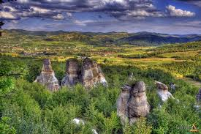
Another story says that Gâlgău Almaşului was once shelter to greedy dragons that would abduct young girls from families of the village. One day one of them went too far and stole the sun from the sky. A young man, outraged at the dragon’s audacity, decided to take him on. He managed to defeat him and once having found the Sun, he put it back up in the sky, where it belonged. But his troubles were not over, because it didn’t take long for the other dragons to come to the rescue of their imperiled brother. They were dazed by the shining of the Sun, spellbound by a girl the young man had released and turned into stone.

Slide 16


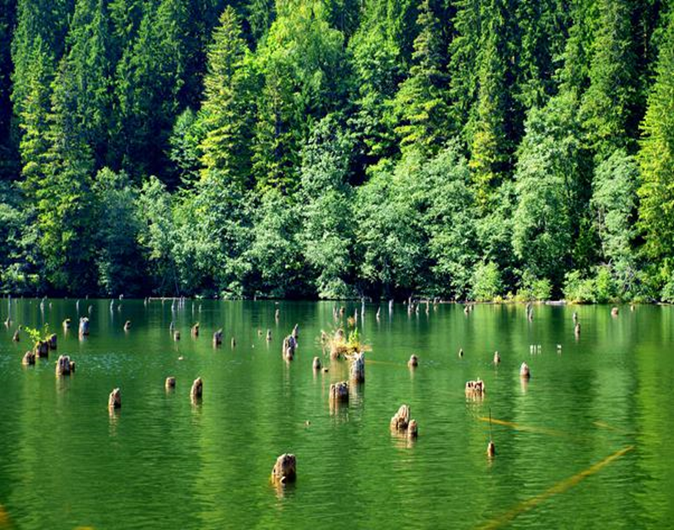
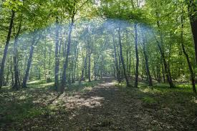
Thank You For Watching

