Slide 1
Legends and Myths

Slide 2

Brought to you from Romania

Slide 3
By
Georgia, Giulia, Denis, Edi, Sebi and Vlad

Slide 4
Baciu Forest makes you feel
Anxiety
Love
Headaches

Slide 5
Alexandru Sift was a/an
Doctor
Biologist
Archaeologist

Slide 6
Dracula

Slide 7
Written by
Bram Stocker
Jan Potocki
Yaşar Kemal
Mihai Eminescu
Sophocles
Almeida Garrett

Slide 8
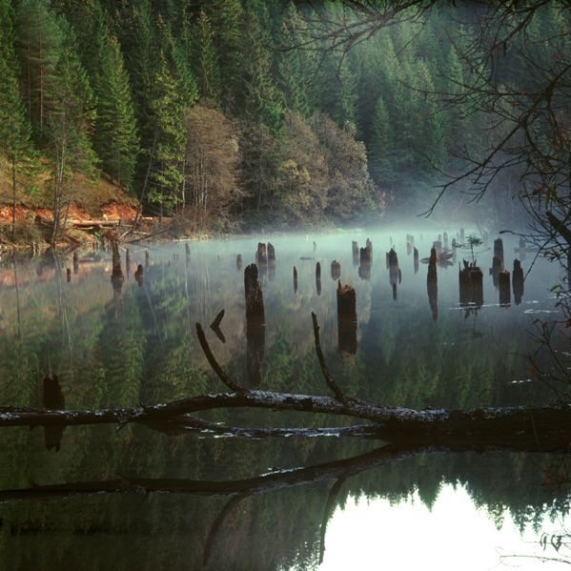
The Red Lake
In the Alps
In the Carpathians
In the Hymalayas

Slide 9
Gods
Roman God
Zamolxes
Greek God
Dacian God

Slide 10
Mesterul Manole
Built a monastery
and inside it he also put….
His father
His sister
His wife

Slide 11
Let’s think of … DRAGON
Rocks
03
Flower .
01
02
River

Slide 12
Thanks!

